Slide 1
Australia Rainfall Prediction
Jack Galloway

Slide 2
Why is it important?
Accurate rainfall prediction is crucial for agricultural planning, water resource management, and disaster preparedness in Australia. It plays a pivotal role in mitigating the impact of droughts, ensuring food security, and preventing devastating wildfires.

Slide 3
Predictor Factors
Rainfall
Evaporation
Sunshine
Minimum temperature
Maximum temperature
Cloud coverage at 9am
Cloud coverage at 3pm

Slide 4
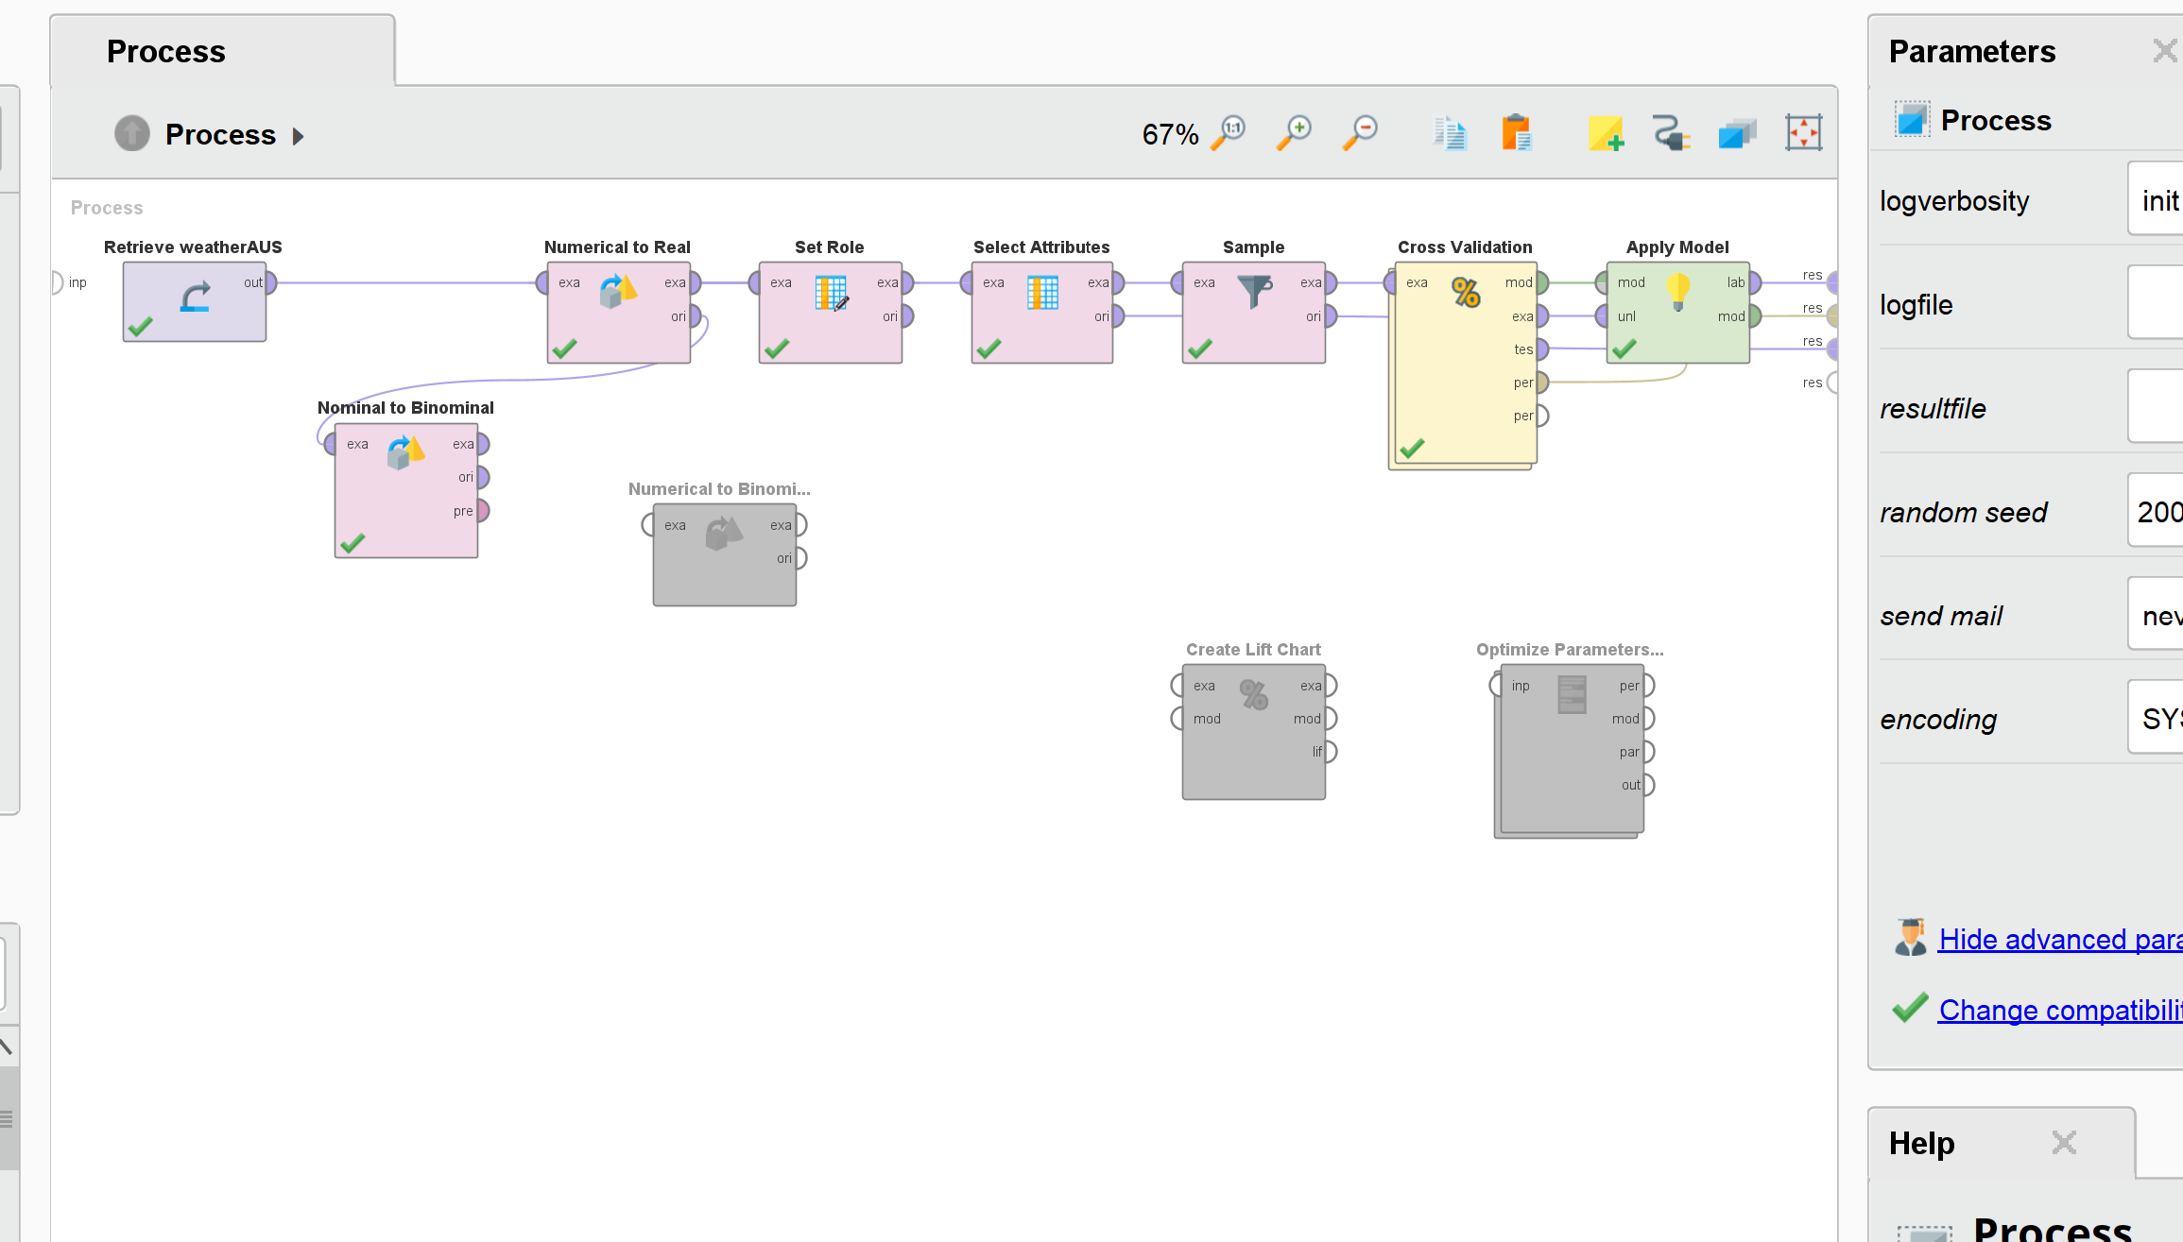
RapidMiner Model

Slide 5
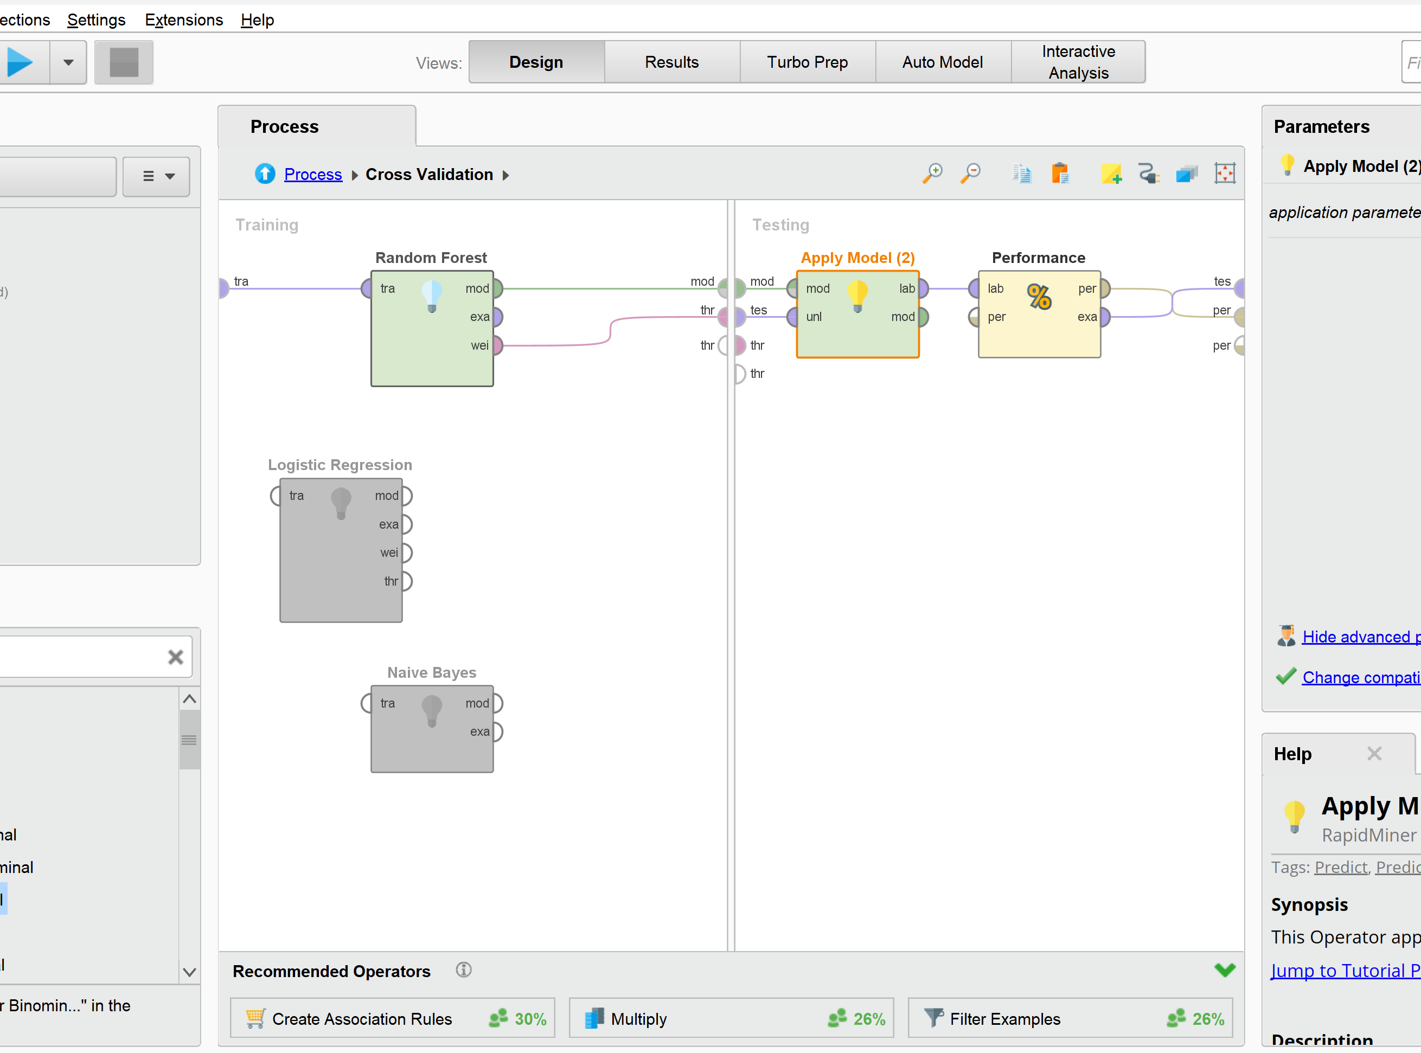
RapidMiner Model

Slide 6
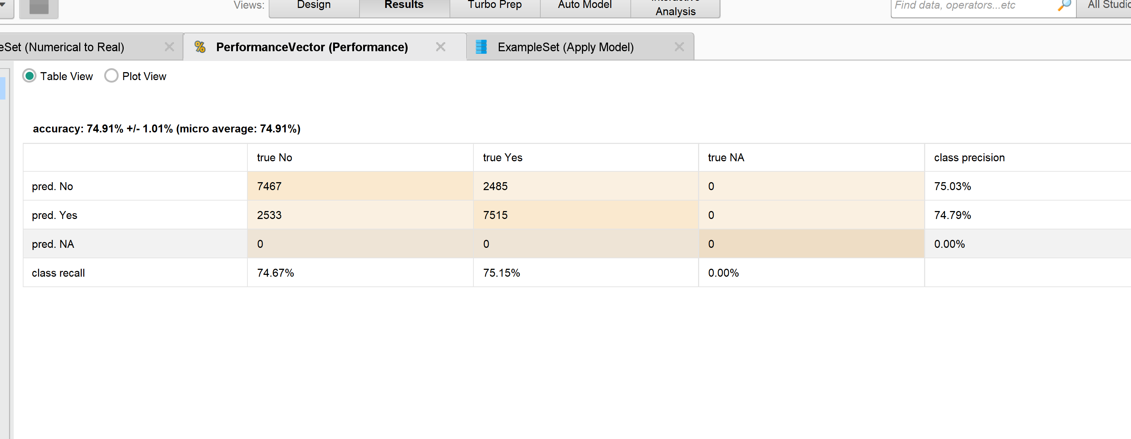
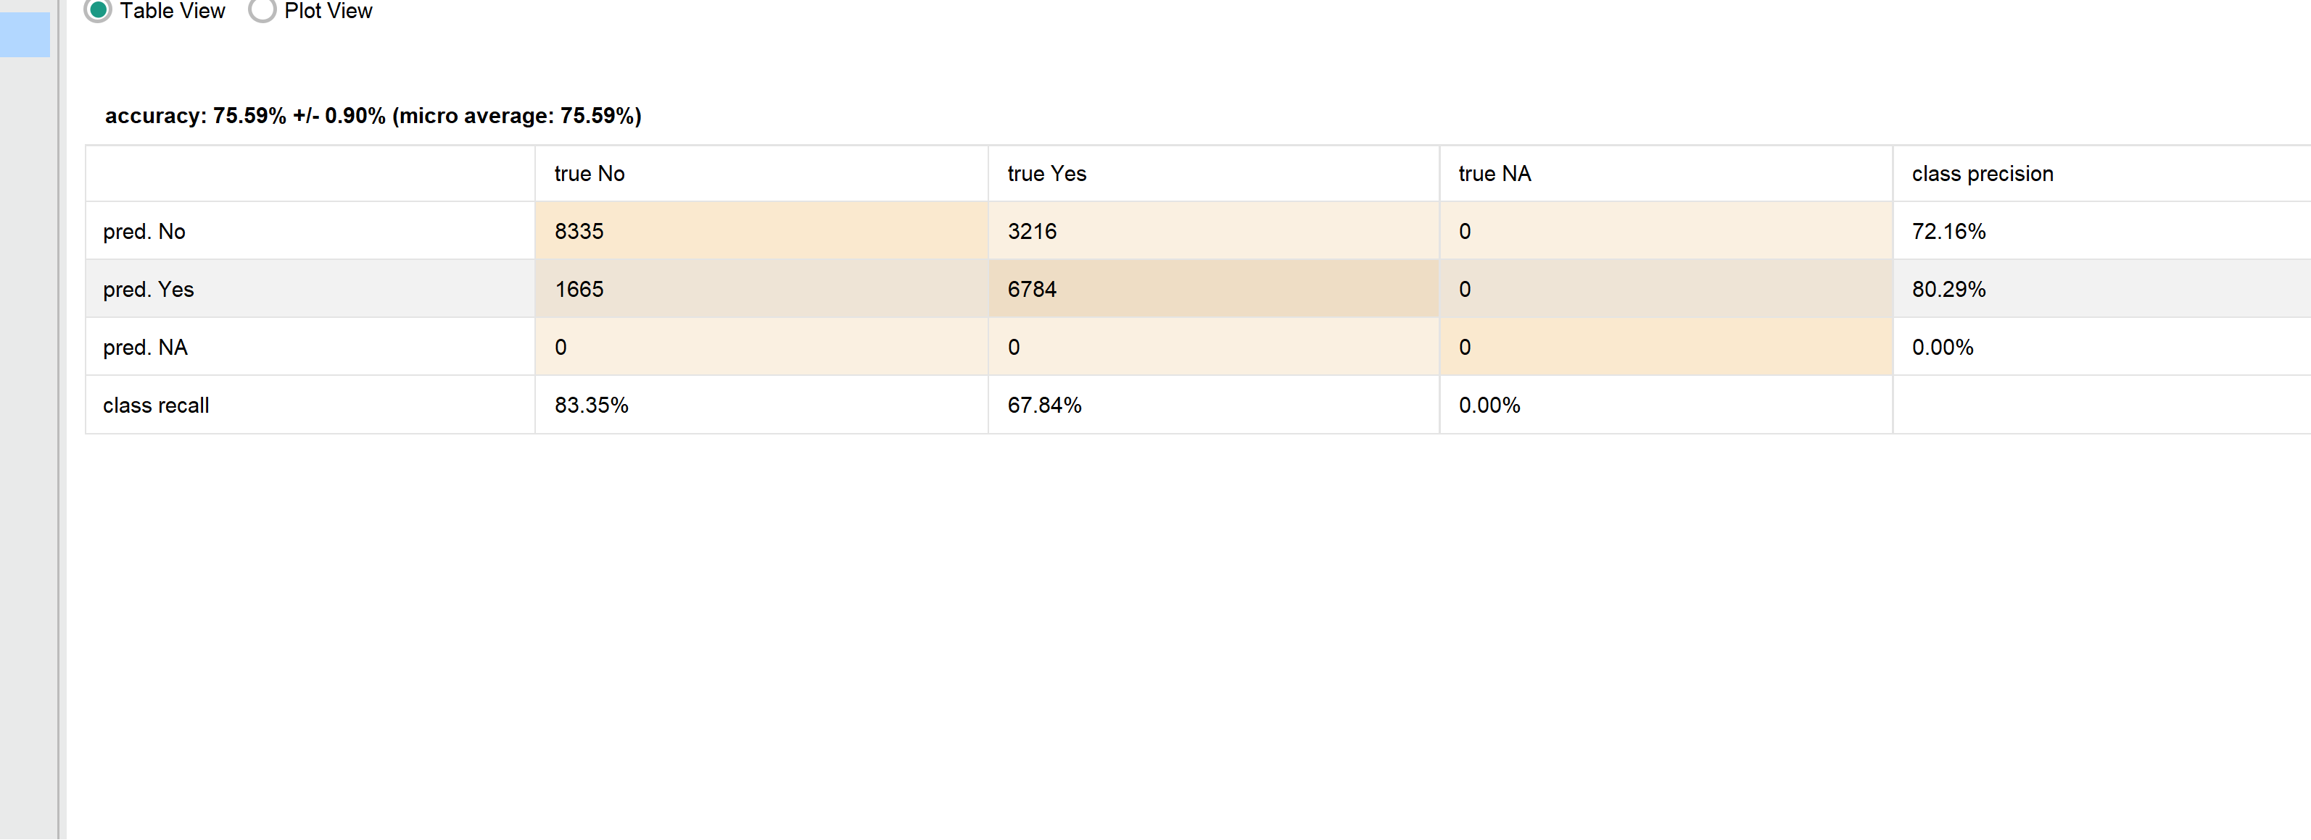
Modeling Accuracy
Naïve Bayes
Random forest

Slide 7
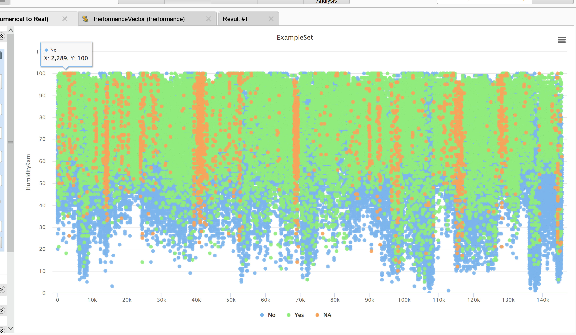
Modeling Accuracy
Naïve Bayes
Random forest

Slide 8

Modeling Implementation

Slide 9
Thank you
Jack Galloway
Jack.galloway379@topper.wku.edu

